Slide 1


CRISPR: From Discovery to Clinic
A concise tour from bacterial immunity to first‑in‑class human therapies—science, delivery, safety, ethics, and markets.

Slide 2

Programmable Medicine
Guided by a short RNA, CRISPR tools cut, nick, or rewrite DNA/RNA—turning sequence into a therapeutic address.

Slide 3
Presentation Roadmap
1.
Discovery & Key Figures
2.
How CRISPR Works (mechanism diagram)
3.
Breakthroughs Timeline
4.
Delivery Modalities (AAV, LNP, ex vivo)
5.
Therapeutic Pipeline Landscape
6.
Market Outlook (size & segments)
7.
Clinical Risks, Ethics & Regulation
8.
Case Studies
9.
What's Next: Future Outlook

Slide 4

Key Figures
Jennifer Doudna, PhD
Emmanuelle Charpentier, PhD
UC Berkeley biochemist; co‑discovered programmable CRISPR‑Cas9 genome editing (2012). Pioneered governance and ethical discourse for genome editing. 2020 Nobel Prize in Chemistry (with Emmanuelle Charpentier).
Microbiologist who identified tracrRNA and co‑invented the CRISPR‑Cas9 editing system. Founding and scientific leadership at the Max Planck Unit for the Science of Pathogens. 2020 Nobel Prize in Chemistry.
"CRISPR is a simple concept with transformative implications when directed with precision and care."
"This technology gives us a way to rewrite the code of life. With that power comes profound responsibility."

Slide 5
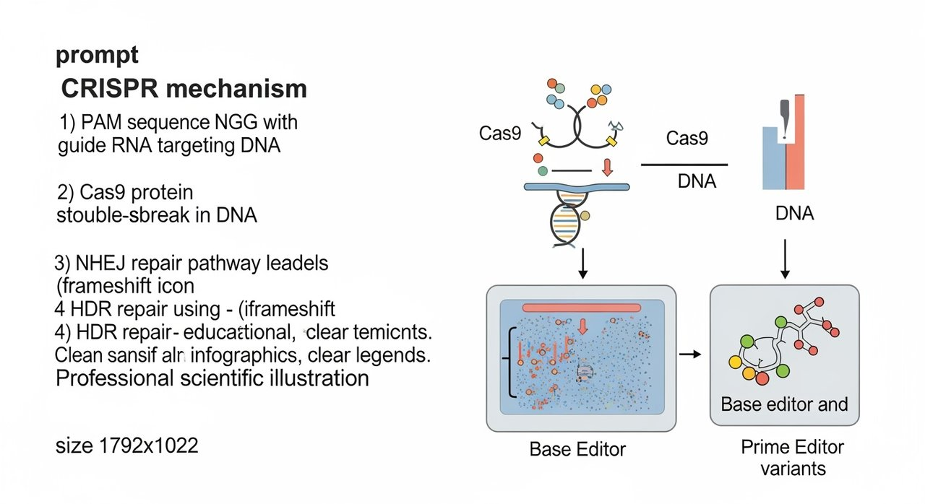
How CRISPR Works
Target selection: Cas9 scans DNA for a PAM (e.g., NGG) and the 20-nt guide RNA (gRNA) base-pairs with the protospacer.
Cutting: Cas9's HNH and RuvC domains cleave opposite strands to create a double-strand break (DSB).
Repair pathways: NHEJ (error-prone, introduces indels) or HDR (precise edits with donor template)
Editor variants: Base editors (ABE/CBE) for single-base conversions without DSB; Prime editor for small insertions/deletions/substitutions

Slide 6
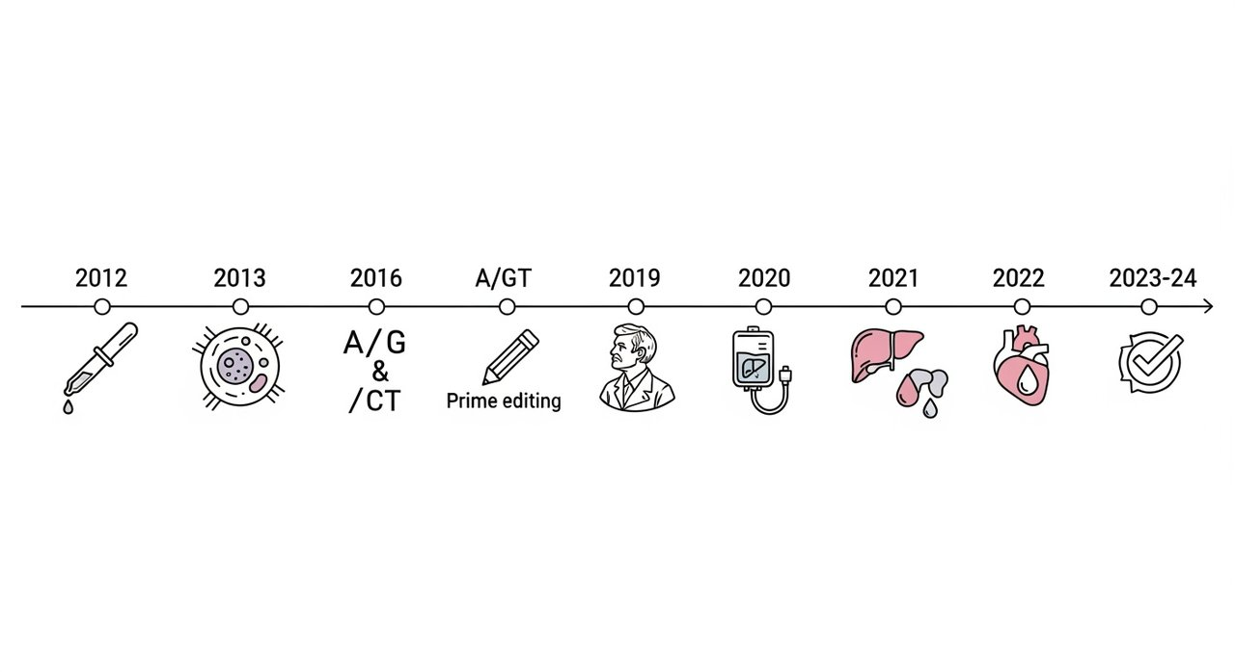
Breakthroughs Timeline
2012 — Programmable CRISPR‑Cas9: In vitro demonstration of RNA‑guided DNA cleavage (Jinek et al., Science)
2013 — Mammalian cell editing: CRISPR‑Cas9 enables targeted gene disruption and HDR in human cells
2016-2019: Base editing introduced (ABE/CBE for DSB-free editing); Prime editing unveiled (insertions/deletions without donor DNA)
2020-2024: Nobel Prize recognition; First in vivo infusion (ATTR); First in-human base editing (PCSK9); First approvals (exa-cel/CASGEVY for SCD/TDT)

Slide 7
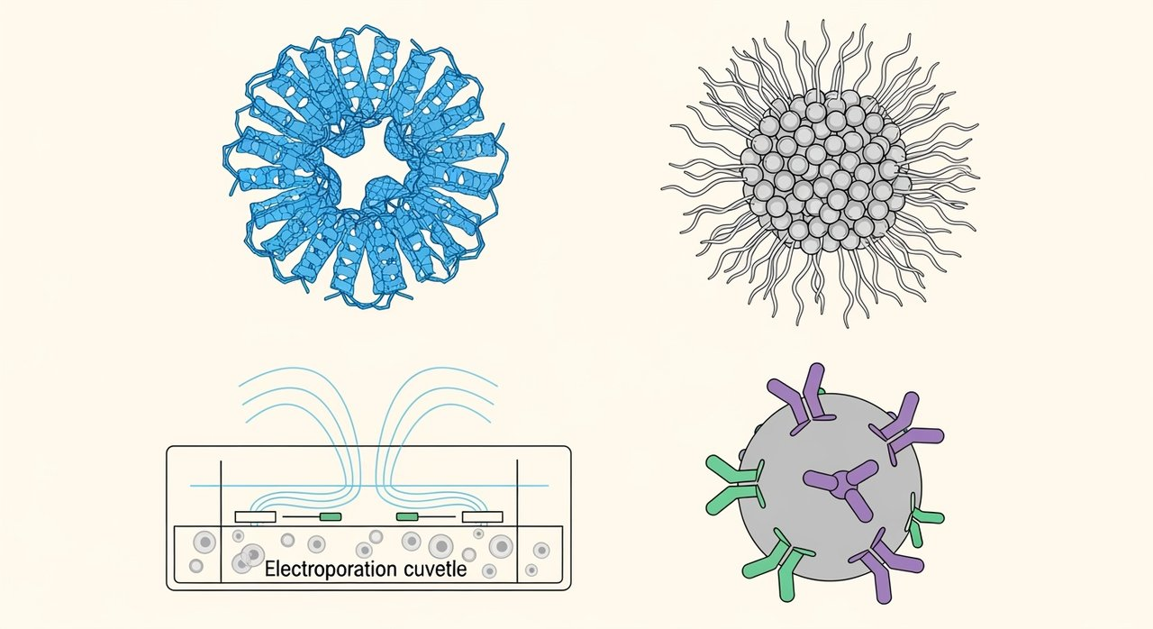
Delivery Modalities: Getting Editors to Cells
AAV
LNP
Electroporation (ex vivo)
Non-viral/Other
Best for: In vivo editing in tissues with suitable serotypes (eye, muscle, CNS)
Best for: In vivo liver delivery; expanding to extrahepatic targets
Best for: Autologous/allogeneic cell therapies (HSPCs, T cells)
Best for: Emerging systemic/extracellular targets
Pros: Strong tropism, single-dose potential, long-term expression
Pros: Transient expression, manufacturability, modular chemistry
Pros: Transient RNP delivery, high editing rates, multiplex capability
Pros: Targeted delivery potential, avoids viral immunity
Constraints: Capsid size limits (~4.7 kb), pre-existing immunity, integration risk
Constraints: Hepatocyte bias, infusion reactions, endosomal escape
Constraints: Manufacturing complexity, conditioning regimens
Constraints: Lower efficiency, formulation challenges
Notables: EDIT-101 (AAV5), dual-AAV systems, compact SaCas9
Notables: NTLA-2001 (ATTR), VERVE-101 (PCSK9)
Notables: Exa-cel/CASGEVY for SCD/TDT, multiplex CAR-T
Notables: VLPs, polymeric/ionizable lipid hybrids

Slide 8
Therapeutic Pipeline Landscape
200+
~40
~10
3-5
1
Discovery/Preclinical
Phase 1
Phase 2
Phase 3
Approved (2023-24)
Disease Categories
Discovery/Preclinical
Phase 1
Phase 2
Phase 3
Approved
Hematology (ex vivo)
Indications: Sickle cell disease, β-thalassemia
Multiple HSPCs
BEAM-101
HSC programs
exa-cel
CASGEVY
Multiple targets
NTLA-2001, VERVE-101
ATTR trials
Cardio-metabolic (in vivo, liver)
Indications: ATTR amyloidosis, PCSK9, Lp(a)
Next-gen capsids
EDIT-101
Ophthalmology (in vivo, ocular)
Multiple CAR designs
Allogeneic CAR-T
Multiplex edits
Indications: LCA10, Choroideremia
Prime/base editors
Targeted LNPs
Oncology (ex vivo)
Indications: B-cell malignancies, Solid tumors
Rare genetic (various)
Indications: AATD, DMD, CNS/hearing targets
First Approved CRISPR Therapy
Name: Exagamglogene autotemcel (exa-cel/CASGEVY)
Modality: Ex vivo CRISPR/Cas9 RNP edit of autologous HSPCs (BCL11A enhancer)
Indications: Severe sickle cell disease; Transfusion-dependent β-thalassemia
Status: First CRISPR therapy approved in multiple regions (2023-24)

Slide 9
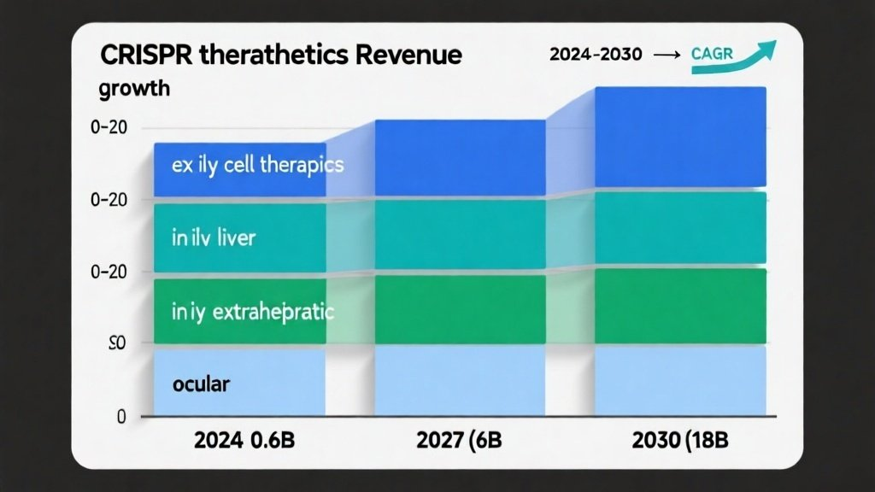
Market Outlook: CRISPR Therapeutics
Projected Revenue Growth (USD billions): 2024: $0.6B → 2027: $6B → 2030: $18B
Segment Breakdown: Ex vivo cell therapies (blue, largest segment); In vivo liver (teal); In vivo extrahepatic (green); Ocular therapies (light blue)
Key Assumptions: Progressive approvals in hematology and liver indications; Manufacturing scale-up reduces costs; Extrahepatic delivery breakthroughs by late decade
Note: For planning discussion only; directional and non-binding; not investment advice

Slide 10
Clinical Risks, Ethics & Regulation
Safety Risks & Mitigations
Ethics & Regulatory Framework
Risk: Off-target edits
Ethics Topics
High-fidelity nucleases (eSpCas9, HiFi Cas9); Guide optimization; Off-target mapping (GUIDE-seq, CIRCLE-seq); Dose minimization and transient delivery
• Somatic vs. germline boundary—therapeutic use only
• Informed consent and data stewardship
• Equitable access and affordability
Risk: On-target complexity
• Pediatric/rare disease risk–benefit calculus
Favor base/prime editors; Allele-aware design; Long-read sequencing; Functional assays for tumor suppressor pathways
• Avoiding enhancement uses and misuse
Regulatory Overview
Risk: Vector-related toxicity
• US FDA: CBER draft guidance (2022) for human genome editing; off-target assessment, CMC, long-term follow-up
Lower doses with potent promoters; Integration site analysis; Patient selection and monitoring
• EU EMA: ATMP framework; gene editing under gene therapy guidelines
• UK MHRA: ILAP/Innovation pathways for accelerated access with risk management
Risk: Immunity to Cas/vectors
Pre-screening for antibodies; Humanized enzymes; Transient exposure; Prophylaxis
• WHO: 2021 recommendations for governance and oversight of human genome editing
Monitoring Toolkit
Amplicon NGS/WGS; GUIDE-seq/CIRCLE-seq; Vector integration assays; Clinical labs; 15-year follow-up registries

Slide 11
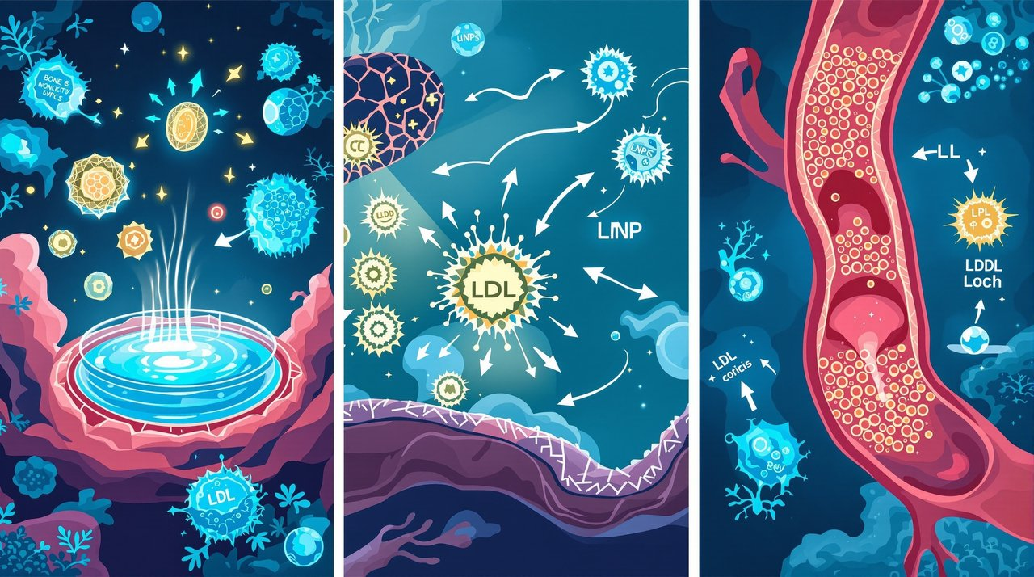
Case Studies & What's Next
Exagamglogene autotemcel (exa-cel/CASGEVY)
NTLA-2001
VERVE-101
Modality: In vivo CRISPR/Cas9 via LNP (mRNA + gRNA)
Modality: In vivo adenine base editor (ABE) via LNP
Modality: Ex vivo CRISPR/Cas9 RNP; autologous HSPC edit (BCL11A enhancer)
Indication: Hereditary transthyretin amyloidosis (ATTR)
Indication: Heterozygous familial hypercholesterolemia (PCSK9)
Indication: Severe sickle cell disease; transfusion-dependent β-thalassemia
Key results: Single IV dose achieves dose-dependent TTR reductions (often >80–90%)
Key results: Sustained LDL-C lowering in early clinical data
Key results: High rates of elimination of VOCs (SCD); Durable HbF induction; transfusion independence in many TDT patients
Notes: Demonstrates systemic in vivo editing feasibility in humans
Notes: First clinical base editing program; long-term durability under observation
Notes: Requires myeloablation and specialized manufacturing/logistics
What's Next
• Prime editing enters/approaches clinical testing for precise corrections
• Targeted LNPs and next-gen capsids broaden beyond liver (lung, muscle, CNS)
• In vivo gene insertion and safe-harbor strategies for durable replacement
• Multiplex editing for off-the-shelf cell therapies with logic gating
• CRISPRi/a and epigenome editing for reversible gene control
• Manufacturing scale-out and outcomes-based pricing to expand access

